Slide 1

Post Graduation Diploma Project PG-DAC Home Rental System
Submitted By
Rakesh Bohite (230343020016)
Suraj Kushire (230343020050)
Shrikant Rane (230343020077)
Shivam Sharma (230343020089)
Guided By
Mrs: Bakul Joshi

Slide 2
Agenda
Introduction​
Architecture
Technology platform used for project
User roles and responsibilities
Division of work within team
Details of contribution of each team members
Use of GitHub in the project
Future extension if any
Benefits
Conclusion

Slide 3
Introduction
Purpose of project
The main purpose of the Home Rental project is to provide a user-friendly online platform that connects property owners with potential tenants. This platform aims to simplify the process of renting properties, increase transparency between tenants and property owners, and eliminate the need for intermediaries like brokers.
Need
When someone is relocating to a new location he/she faces issues for accommodation & living. As well as Property owners don’t have any specific platform to advertise their properties. There is no transparency between tenants & property owner
Beneficiaries of Project
The Home Rental project benefits tenants by providing an efficient platform to find, compare, and rent properties. Property owners gain direct access to potential tenants, streamlining the rental process. The platform enhances transparency, making property transactions easier for both parties.

Slide 4
Project Architecture
Used for
Permanent data storage
Database level validation
Database access using stored procedures
Used for
Server side validation
Response handling
Business Logic
Database operations
Used for
User interfacing
Basic data validation
Front end Layer
Server Layer
Database Layer
Technologies used
HTML, CSS
JavaScript, jQuery
ReactJS
JSON
Technologies used
SpringBoot
Hibernate
Technologies used
MySQL

Slide 5
Technology platform used
Technologies used :
HTML, CSS, JavaScript, jQuery, ReactJS, JSON, SpringBoot, Hibernate, MySQL
Reason :
HTML CSS and JavaScript are used for frontend part for static web pages.
React JS is used for rendering the dynamic web pages and to create a single page application where only particular part of web page is rendered without altering complete web page.
SpringBoot is used for server side processing wherein in connection with database is established from server and required data is manipulated and sent to client side.

Slide 6
User roles and responsibilities
User Roles :
There are three most important roles assigned to users. Like Admin, Tenant, and Owner for Home Rental System.
Admin : Manage Tenants, Owners and properties.
Tenant : Tenants are individuals or families looking for rental properties to live in.
Owner : Home owners are individuals who own properties and want to rent them out to potential tenants.
User Case According to roles :
Admin : Manage users, properties and transactions.
Tenant : View the properties and request for owner info.
Owner : Can upload the property after sign In.

Slide 7
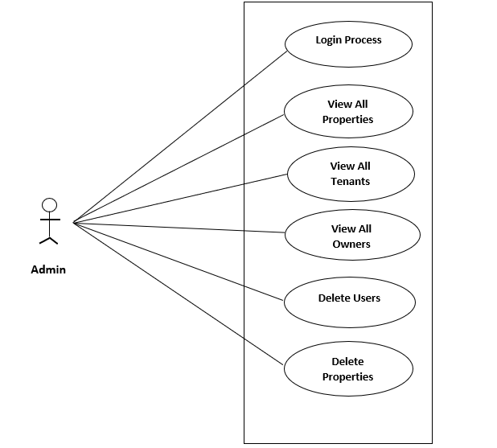
Use case Diagram- Admin Module

Slide 8
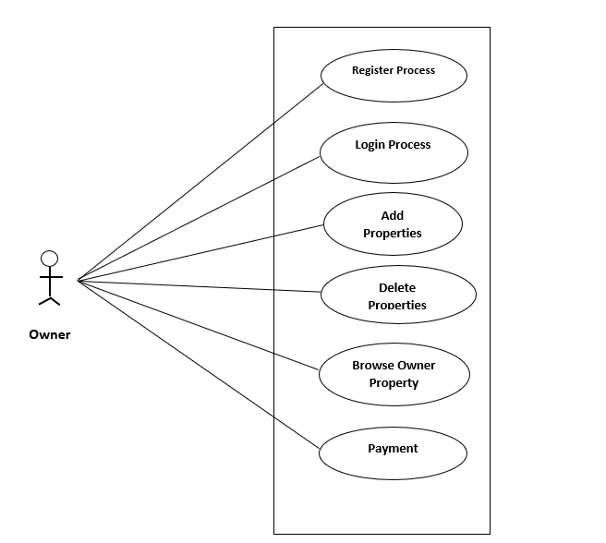
Use case Diagram- Owner Module

Slide 9
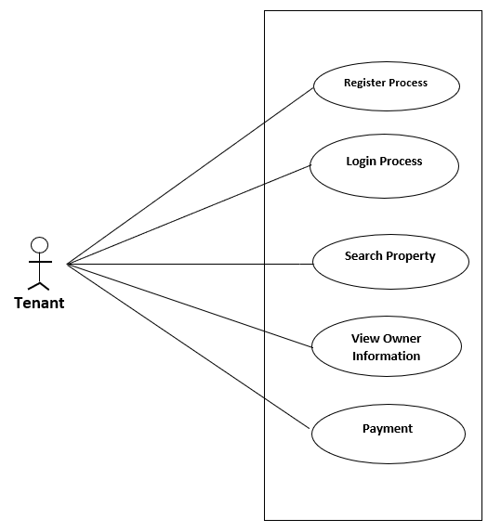
Use case Diagram- Tenant Module

Slide 10
Division of work within team
Suraj Kushire : Implemented the ShowAll properties, Tenants and Payment
Shrikant Rane : Implemented login, logout and add properties
Shivam Sharma : Implemented on Home component for all users.
Rakesh Bhoite: Implemented Register pages for all users
Stages at which Coordination was needed
Most of the coordination was needed when complete UI needed to be rendered using React,
Every one worked together for designing the database (Backend)

Slide 11
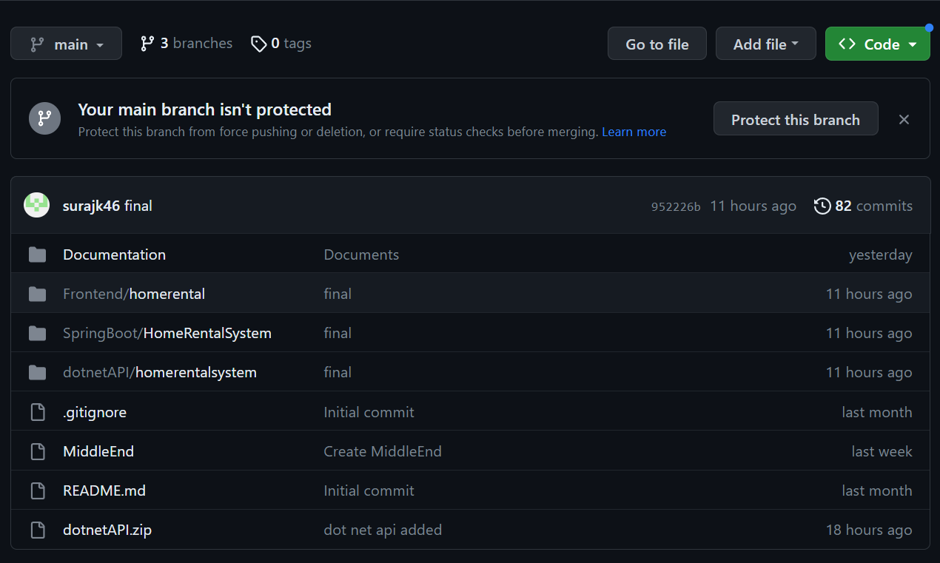
Use of GitHub in the project
Git Url: https://github.com/surajk46/HomeRentalSystem

Slide 12
Future extension if any
Future extensions for the Home Rental project could include:
Mobile App Development: Creating mobile apps for Android and iOS to enhance user accessibility and engagement.
Payment Integration: Integrating payment gateways for seamless rental transactions and secure online payments.
Advanced Search Filters: Implementing advanced search options like filtering by amenities, location, and price range.
Rating and Reviews: Adding a rating and review system for properties and tenants to build trust within the community.

Slide 13
Benefits
Convenience for Tenants and Owners: The platform streamlines the property search and rental process, making it convenient for tenants to find suitable homes and for property owners to connect with potential tenants without intermediaries.
Transparency: By providing detailed property information, images, and direct communication, the platform fosters transparency between tenants and property owners, enhancing trust and reducing misunderstandings.
Time and Cost Savings: Tenants can efficiently search and compare properties online, saving time and effort. Property owners can reach a broader audience without traditional advertising costs.
Direct Communication: Enabling direct communication between tenants and property owners fosters personalized interactions, allowing both parties to clarify terms and negotiate effectively.
Enhanced User Experience: A user-friendly interface, advanced search options to an enhanced user experience.
Efficient Management: The administrator module allows efficient management, and moderation of properties and user accounts.

Slide 14
Conclusion
Challenges we faced : There were many challenges that we faced like finding a write path to start with, exploring the learned technologies beyond the horizon of our course Etc.
Things Learnt : We have learnt to efficiently distribute the task within the team. We have learnt to combine all the dynamic stack of technologies together to create a fully functional software.
Overall Experience : Overall experience was very practical oriented and highly knowledgeable.

Slide 15
Thank You

